Slide 1
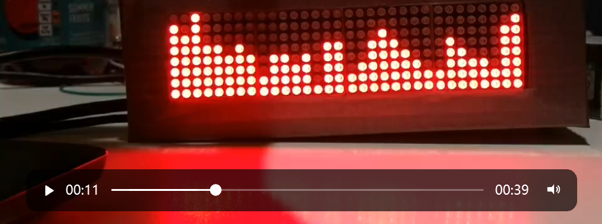
Frequency Spectrum Visualizer
Notes:
Which senses the music you play out loud in the environment

Slide 2
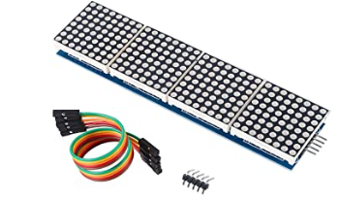
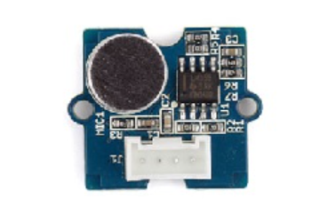
Sensors & Actuators
Sound sensor module V1.6 (A microphone and an amplifier)
LCD module MAX7219
Press button to change display mode

Slide 3
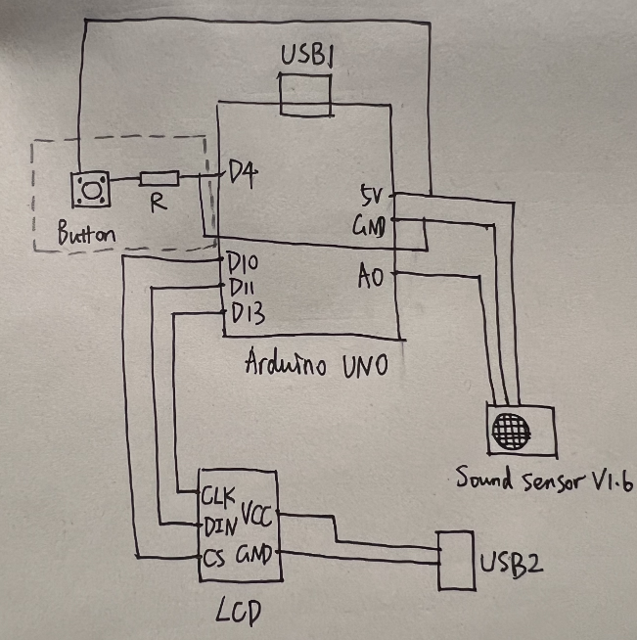
Circuit Pin Layout
Notes:
When they connect to the same power, pass EMI. I tried capacitors. I guess drawing too much power.

Slide 4
Data Flow
ADC: sampling frequency 38 kHz by setting ADC prescaler to 32
Averaging: remove part of the noise in ambient
FFT: the number of samples in each calculation is 64
Displayed on LCD

Slide 5
External Resources
Existing project that displays the frequency spectrum of audio signal fed from headphone output or Line-out of music system
Use FFT to process data. Code source from: https://www.norwegiancreations.com/2017/08/what-is-fft-and-how-can-you-implement-it-on-an-arduino/
Notes:
Averaging(noise), interference

Slide 6
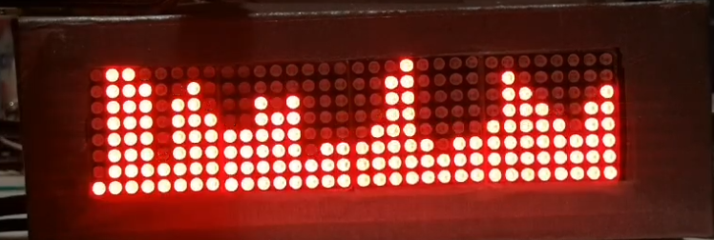
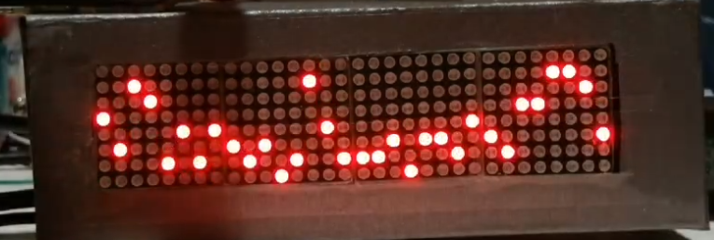
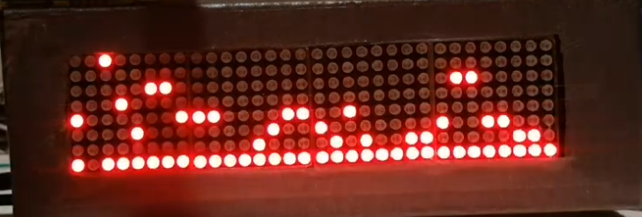
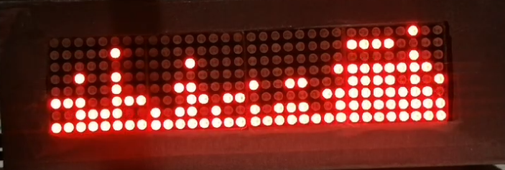
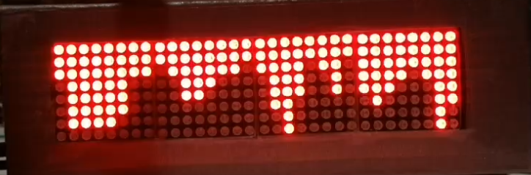
Outcome
Five display modes:

Slide 7
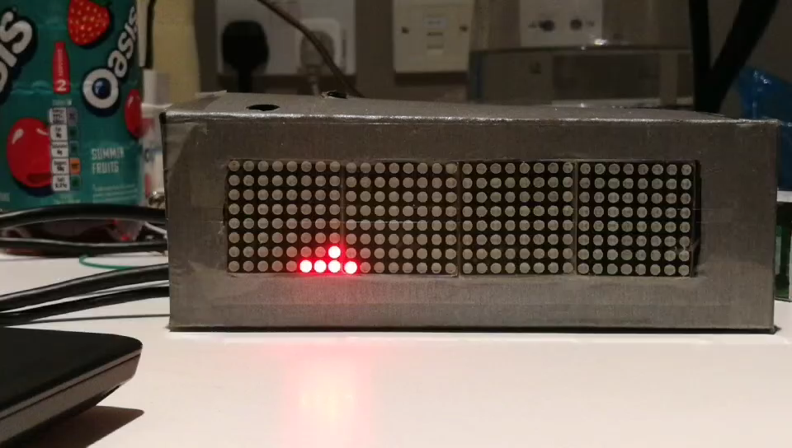

Slide 8
Two Improvements
Add a high-pass filter in the program for ambient noise.
Another way to eliminate interference transmitted through power line instead of using 2 power cables.

